Slide 1
The sound of the Earth from 6 miles subsurface
(turn up your speakers)
Lotte Geeven – Discover Magazine

Slide 3
Agenda
Introduction to CEBN (Power Connector)
Overview of Geothermal Geophone Prize
Panel Discussion
Teaming
Notes:
Geothermal Geophone Prize

Slide 4
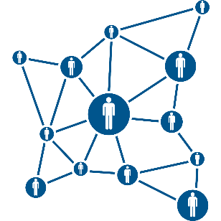
the small business voice for the clean energy economy
Policy Support
Market & Technology Education
Business Development Assistance
©2022 CEBN

Slide 5
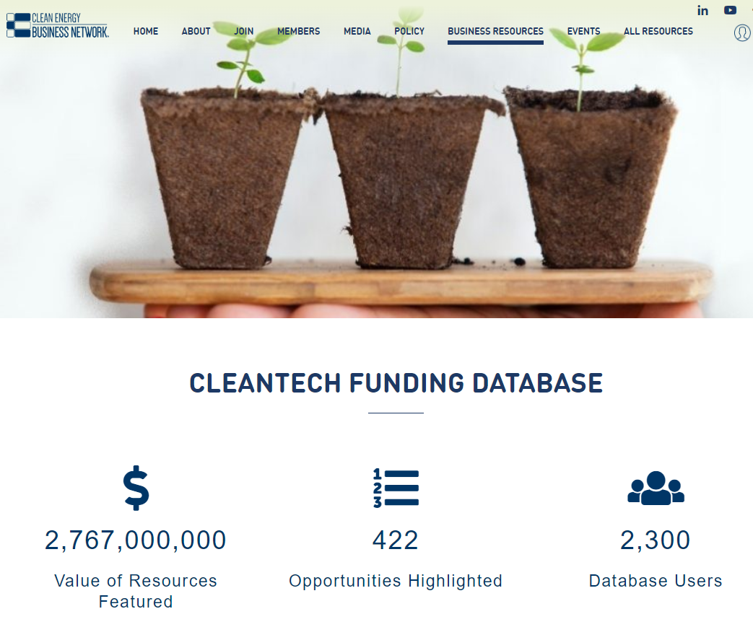
CEBN Resources
U.S. Cleantech Funding Database
1:1 Office Hours
Teaming Form
cebn@cebn.org
©2022 CEBN

Slide 6
American-Made Challenges
Geophone Prize
Phase 1: Concept!
Email: geophoneprize@nrel.gov
Notes:
Geothermal Geophone Prize

Slide 7
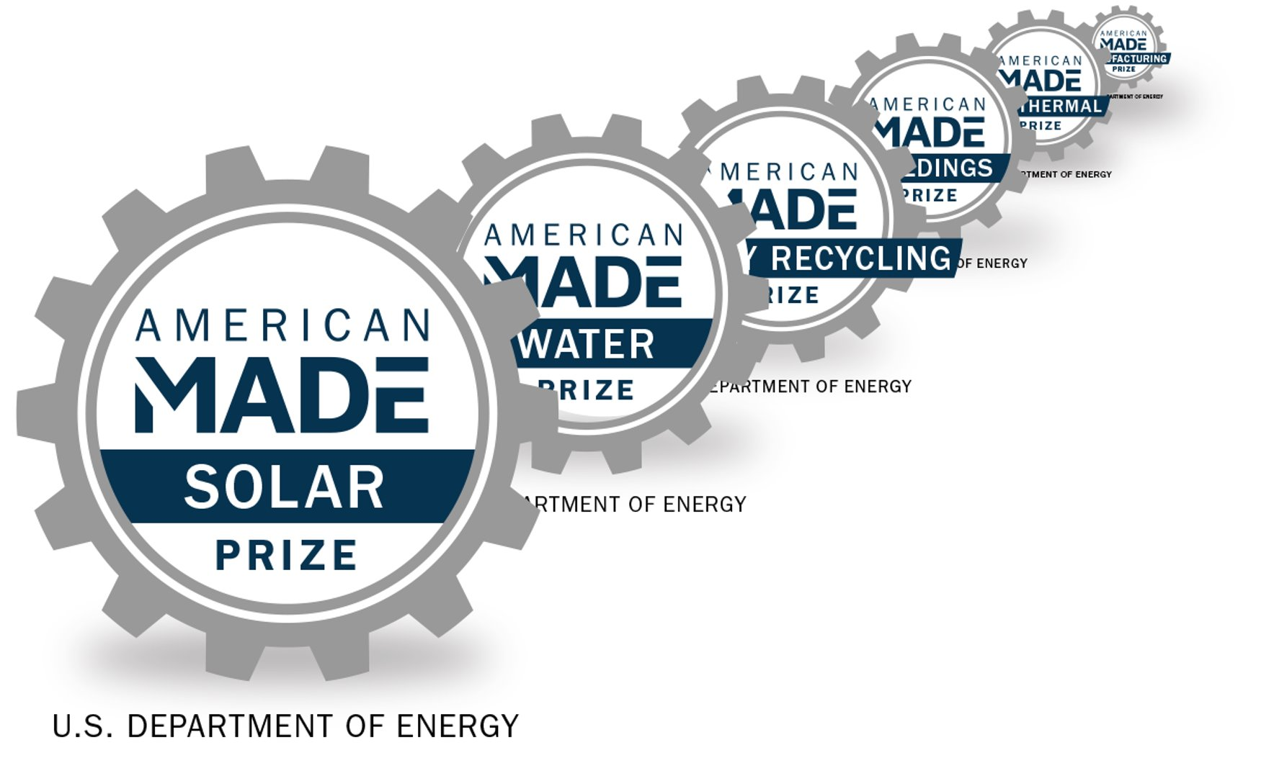
American-Made Challenges
Notes:
We house the Geothermal Geophone Prize under our American-Made Challenges program. What is the American-Made Challenges program? The American-Made Challenges program currently represents more than 10 offices within the U.S. Department of Energy, 250 plus organizations, and $100M in cash prizes….. This program supports 30+ unique prize challenges everywhere from solar to water to geothermal, to hydrogen and the list goes on.
The foundation of American-Made Challenge are the prizes we facilitate, while creating partnerships that connect entrepreneurs to the private sector and the US Department of Energy national labs.
and thanks to rapid timelines and goals……prizes, fast-track product development from years to months...this truly allows for rapid innovation cycles…We do our best to get expertise, resources, and funds into the hands of inventors, as quickly as we can.

Slide 8
What is the Geophone Prize?
$3.65M Prize Competition Phase 1: Concept
Phase 2: Make
Phase 3: Build
Support from National Network American-Made Network
Notes:
What is the Geophone Prize? (Go over cash competition and phases)
And also as I mentioned with the American-Made Challenges Program this prize includes the support of 250 + organizations also know as the American- Made Network.
This network includes, business, universities, labs, and organizations also called Connectors who help identify competitors for prizes and support them as they refine their innovations and submission packages.
The Network is growing rapidly with Connectors across the country... And they can support you and your team with technical support, business support, financial support…and so on.
Something to note is that connectors are rewarded for supporting team, so it is worth your time to reach out and to ask for support. We have a network matching tool where teams can connect directly with connectors.
And with this, we also contract specific organizations to work on our prizes- which are known as Power Connectors. Clean Energy Business Network that is holding this great event today is our Power Connector for this prize and is here to help you! So do not hesitate to reach out.
And of course this is a quick overview of the prize- but we ask for you to please be sure to read the rules in detail on the HeroX sight as well as review the Phase 1 informational webinar in more detail to learn about all of the details for this prize.
Networking matching tools:
https://network.americanmadechallenges.org/

Slide 9
Phase 1: Concept! Goal
Participants will demonstrate that they have identified and developed an initial concept for a high-temperature, downhole seismic sensor that utilizes currently available components, or a prototype currently under development. Propose a path to design, prototype, and test a proof of concept.
Notes:
For Phase 1, what is our goal? The goal is that….Teams will propose…

Slide 10
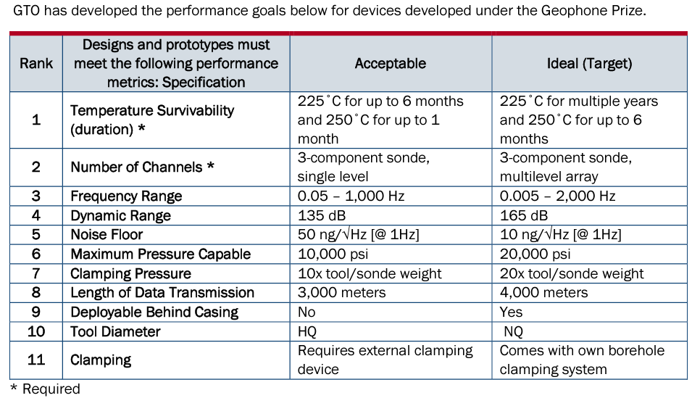
Performance Goals
Notes:
GTO is looking for specific performance metrics in everywhere from temperature survivability of your prototype, to frequency range. And the columns on the right is what GTO is looking for for an acceptable range of these specifications and also an ideal range. We encourage teams to review this specifications table in the rules document on HeroX as they begin their submission to Phase 1. Again, this is a quick overview, because we want to have time for the panel and for each of you to be able to network and connect with one another, and we ask to learn more details about the prize to please review all the information for this prize on HeroX.

Slide 11
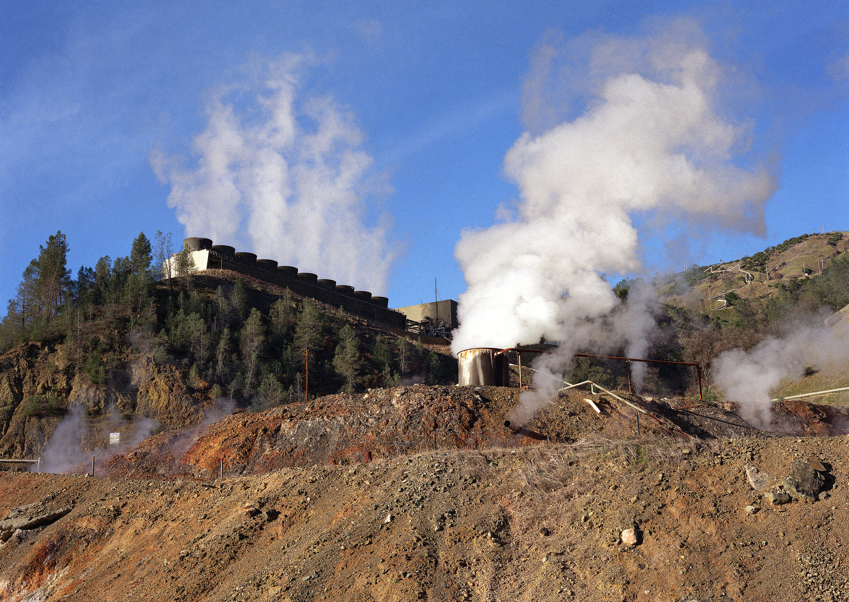
Panelists
Lisa Trope, Project Manager for the American Made Challenges, National Renewable Energy Lab
Ernest Majer, Affiliate Scientist, Earth & Environmental Sciences Program, Lawrence Berkeley National Lab
Michelle Robertson, Earth & Environmental Sciences Program Manager, Lawrence Berkeley National Lab
Craig Hartline, Senior Geophysicist, Calpine
Tim Latimer, CEO, Fervo Energy
Nicolas Goujon, Technical Advisor, Stryde

Slide 12
Supplementary Materials
Notes:
Geothermal Geophone Prize

Slide 13
Objectives of Seismic Monitoring
Understand reservoir dynamics for managing injection effects
impact of seismicity on surrounding communities
Impact of seismicity on reservoir performance
Satisfy the requirements to provide detailed real-time monitoring, to the public and scientific community
Data to perform research to advance the understanding between fluid injection/withdrawal and MEQs to optimize reservoir performance and induced seismicity mitigation
Support DOE mission in advancing geothermal energy
Ernest Majer, LBNL
Notes:
13

Slide 14
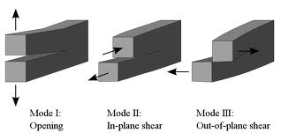
Why do We Need High Temp Sensors for Monitoring the Seismic Signals Associated with the Hydrofracture/EGS Process The fracturing/faulting process is a complicated mixture of different fracture mechanisms, each interacting with each other to control permeability creation. It is rarely monitored with instrumentation necessary to capture the total dynamic range and bandwidth of the resulting seismicity. (i. e., we are missing the important data )
Each process has an implication for fluid paths and permeability enhancement for the bandwidth of and magnitudes seismic signal
Ernest Majer, LBNL

Slide 15
How does magnitude (Mo) depend on “fault” size?
Magnitude versus fault size
Log A = 1.21 M – 5.05 (Kanamori and Anderson 1975)
M = Log A +4.2 (Kanamori 1977)
A = fault areas in Km²
Mag -3 = 5 cm x 5 cm
Mag -2 = 20 cm x 20 cm
Mag -1 = . 75m x .75 m
Mag 0 = 3m x 3m
Mag 1 = 12m x 12m
Mag 2 = 50m x 50m
Mag 3.5 = 400m x 400m
Mag 4.5 = 1500m x 1500m
Magnitudes are proportional to 1/Fc cubed
Fc is the high frequency content of the seismic signals
Ernest Majer, LBNL

Slide 16
Instrumentation Needs
High temperature at least 225 C
High dynamic range, > 160 dB
Wide band width, .01 to kilohertz
Three component
Low noise nano g per root Hz.
Implies borehole installation of transducer
Consider a wide range of technologies
Optical
PZT, IEPE, variable capacitance (VC)
Inertial
Etc.
Beyond commercial seismic instrumentation
Must be cost effective!!!
Ernest Majer, LBNL

Slide 17
3D Structural Model Analysis Example With Volume Slicer Video One
Purple Disc Radii Proportional To Cumulative Water Injection Volume
Initially High-Angle Oblique View From South;
Transitions To Cross-Sectional View From South
Historical Water Injection Wells
Cumulative Injection Volumes
Seismicity Hypocenters
USGS Double-Difference
1984 to Present
3D Structural Model Surfaces
Listed From Top to Base
Surface Topography
Surface Geologic Mapping
Top Greenstone (limited)
Top Serpentinite (limited)
Base Serpentinite (limited)
Top Steam Reservoir
Top Main Graywacke
Top Hornfelsic Graywacke
Top Granitic Intrusion (Felsite)
Base Steam Reservoir
15000’ Subsea
Microseismic Stimulated Reservoir Analyses
26 July 2022 Geothermal Geophone Prize Workshop Craig Hartline Senior Geophysicist

Slide 18
3D Structural Model Analysis Example With Volume Slicer Video Two
View From South and Above Horizontal
Purple Disc Radii Proportional To Cumulative Water Injection Volume
Oblique View From SSW and Above Horizontal
Historical Water Injection Wells
Cumulative Injection Volumes
Seismicity Hypocenters
USGS Double-Difference
1984 to Present
3D Structural Model Surfaces
Listed From Top to Base
Surface Topography
Surface Geologic Mapping
Top Greenstone (limited)
Top Serpentinite (limited)
Base Serpentinite (limited)
Top Steam Reservoir
Top Main Graywacke
Top Hornfelsic Graywacke
Top Granitic Intrusion (Felsite)
Base Steam Reservoir
15000’ Subsea
Microseismic Stimulated Reservoir Analyses
26 July 2022 Geothermal Geophone Prize Workshop Craig Hartline Senior Geophysicist

Slide 19
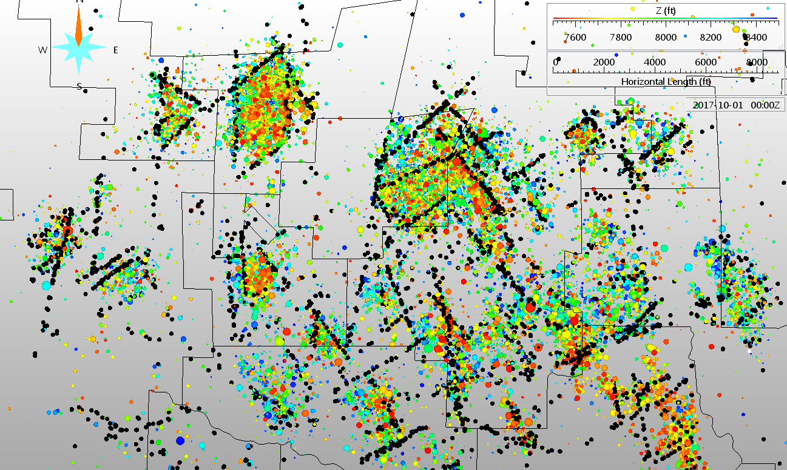
Fracture/Fault and Structural Boundary Interpretation From Seismicity Patterns Northwest Geysers Seismicity Depth Slice From 7500’ to 8500’ Subsea
Prati 9
Prati 32
Prati
State
54
OS15
OS16
The induced seismicity patterns are indicative of fluid flow pathways and fluid flow boundaries
The steam reservoir appears to be subdivided by intersecting zones of faulting and fracturing, resulting in steam reservoir compartmentalization.
26 July 2022 Geothermal Geophone Prize Workshop Craig Hartline Senior Geophysicist

Slide 20
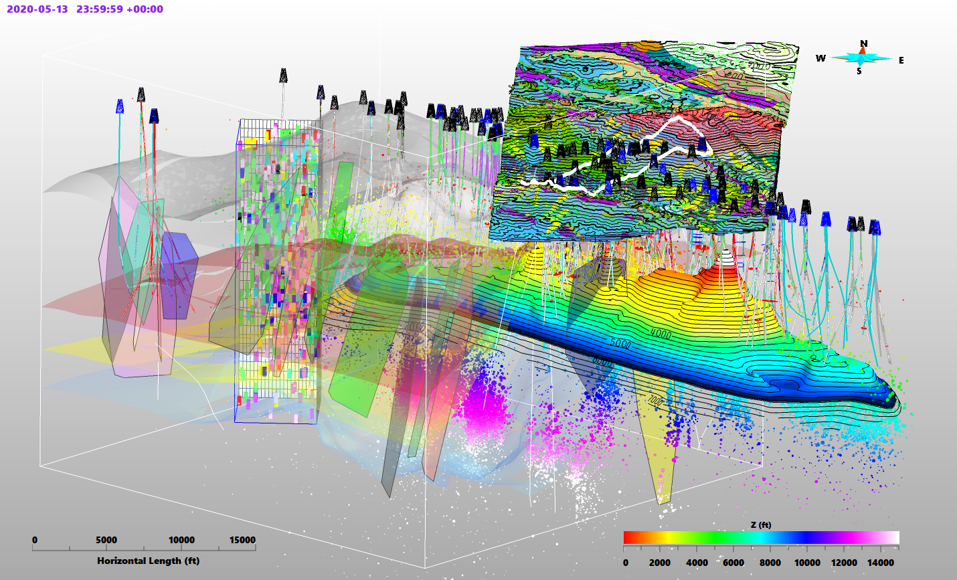
3D structural model constraints include lithology logs for over 940 well segments, steam entries, temperature logs, pressure logs, tracer patterns, heat flow patterns, non-condensible gas patterns, surface geologic maps and induced seismicity hypocenters.
A refined understanding of fluid flow paths, fluid boundaries, reservoir heterogeneity and reservoir compartmentalization assists with well planning / targeting, real-time drilling analysis, reservoir management and provides the potential for improved seismicity mitigation at The Geysers.
Topographic Surface
With Geologic Mapping
Slicer Volume Easily
Extracted For Analysis
Prati 32 EGS
Microseismic
Stimulated
Reservoir
Analysis
Volume
Oblique View
From South
Polygon
Long Axis SW01
Well Trajectories
Lithologic
Surfaces
Offset
By Faults
Top Felsite
Polygon
Long Axis SW01
Seismicity Hypocenters
Selected Fracture
Surfaces
26 July 2022 Geothermal Geophone Prize Workshop Craig Hartline Senior Geophysicist

