Slide 1

Low-Carbon Fuels Standards and Transportation Decarbonization | 02.22.21
©2021 CEBN

Slide 2







the small business voice for the clean energy economy
OUR MISSION
Policy Support
Market & Technology Education
Business Development Assistance
©2021 CEBN
Notes:
The Clean Energy Business Network serves as the small business voice for the clean energy economy. We work to enhance opportunities for clean energy technology and service providers through policy support, market and technology education, and business development assistance. We are a nonprofit, nonpartisan organization.

Slide 3
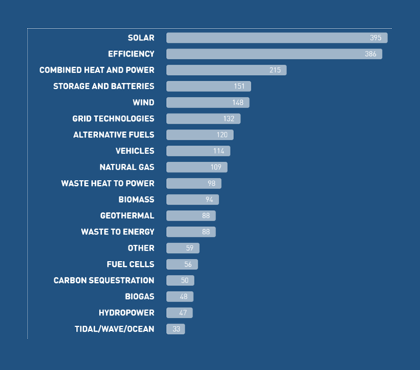
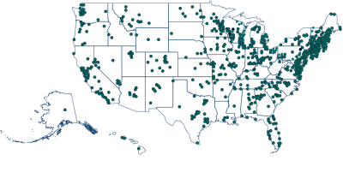

OUR REACH
5,000+ small and midsize business leaders across 50 states
Diverse technologies
©2019 CEBN
©2021 CEBN
Notes:
Our membership spans more than 4,400 clean energy business leaders across all 50 U.S. states, primarily from small and midsize companies. These businesses work across a diverse range of zero- and low-carbon technologies representing the breadth of the clean energy industry.

Slide 4
KICKSTARTERS:
Jonathan Lewis, Clean Air Task Force
Suzanne Hunt, Hunt Green
©2021 CEBN

Slide 5
Clean fuel standards and transportation decarbonization
Should LCFS-type policies go national?
February 22, 2021
Jonathan Lewis | Senior Counsel

Slide 6
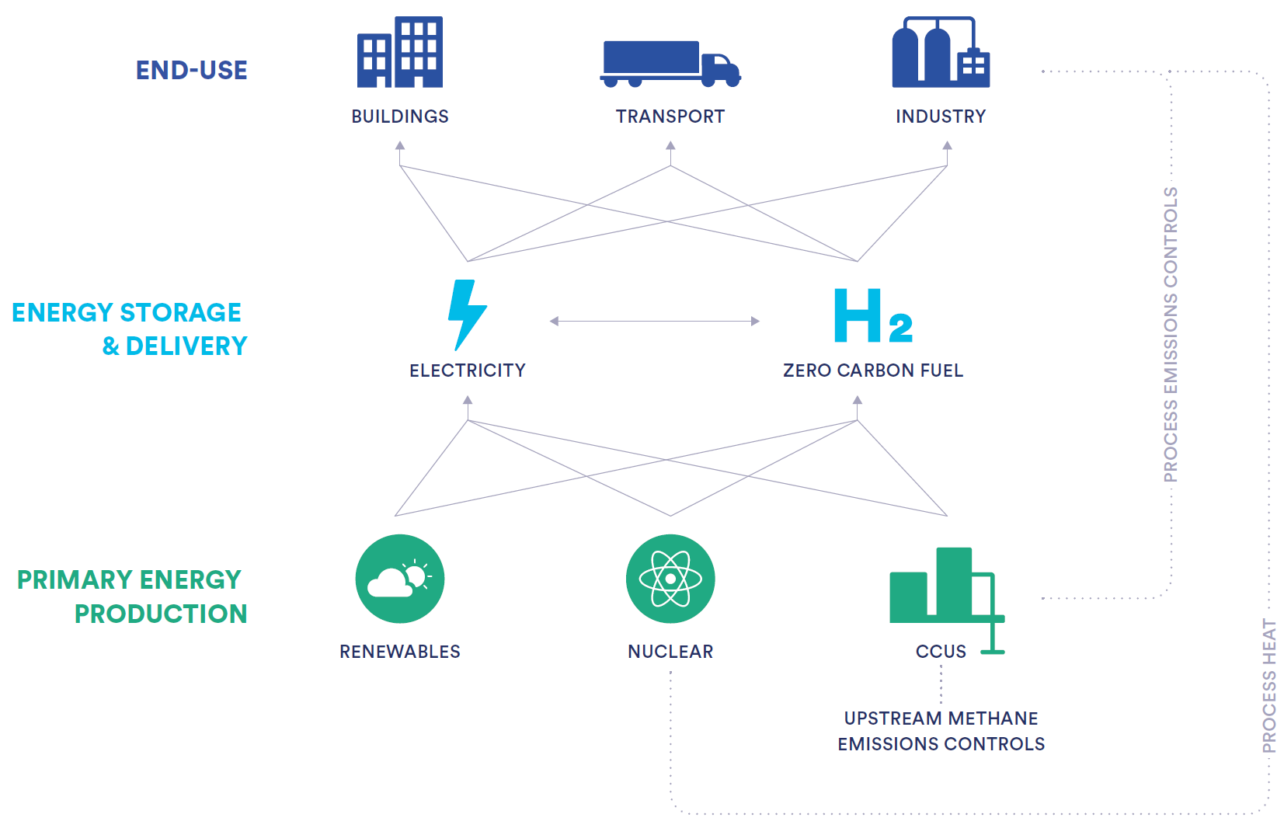
About CATF
Our Mission: Push the change in technologies and policies needed to get to a zero-emissions, high-energy planet at an affordable cost.
Our Goal: Achieve zero-emissions energy, waste, agricultural, and forest management systems by 2050.
Our Vision: Meet the world’s rising energy demand in a way that is financially, socially and environmentally sustainable.
Practical Climate Problem Solvers: Our goal is to explore any plausible solution that offers promise, even if it is not in the environmental or philanthropic mainstream.
For over 20 years, CATF experts have pushed change to get to high energy, zero emissions, affordable technologies and policies through strategic partnerships and collaborations. We always look for new opportunities to engage with like-minded people locally and internationally.
Global Scope: Staff in US, EU, Middle East, and China.

Slide 7

CATF Transportation Decarbonization Project
Innovation oriented: Transportation decarbonization will require targeted investments in critical technologies, not just a carbon price.
Globally scoped: Some of the most interesting innovation is happening outside the US, especially in Japan, China, South Korea, and Europe. Fuels are / will be globally-traded commodities.
Focused on systems that deliver and convert energy: In addition to regional planning, demand reduction, vehicle automation, etc.
Inclusive technology focus: Focused on HDVs, a largely neglected subsector responsible for almost half of the global transportation sector GHG emissions, and on the non-electric markets for LDVs.
Zero-C energy from all sources, not just renewables: CATF’s assessments of the supply and cost of low/zero-C energy incorporate analyses of fossil fuel reforming with CCS, nuclear-powered electrolysis, etc.

Slide 8
Overview of low carbon fuel standard-type policies
The concept and its strengths
Overview
Regulate the carbon intensity (CI) of transportation fuels, rather than the total amount of CO2 released through fuels, by setting a CI standard percentage reduction from the petroleum-based reference fuel (diesel, E10 gasoline, jet fuel) that decreases each year.
Implemented or under discussion
Implemented: California (2011), British Columbia (2011), Oregon (2016)
Under discussion: New York, New Mexico, Washington, Colorado, Midwest US, Canada, Brazil, United States, elsewhere?
Core strengths
By allowing market players to utilize any technology or system that delivers carbon intensity reductions, LCFS-type policies can encourage innovation by opening the decarbonization challenge to an unlimited set of potential solutions.
If various technologies compete on a level playing field, then competition should lead to the deepest, fastest and most cost-effective carbon intensity reductions.
Spillover benefits to other fuel-consuming sectors.

Slide 9
Improving LCFS-type policies
Changes to the LCFS that would it make it stronger, fairer, and more durable
Explicitly target full elimination of GHG emissions from the transportation sector by mid-century—i.e., make it a zero carbon fuel standard (ZCFS) instead of an LCFS.
Policies need to signal to the market that long-term demand will be for energy carriers and vehicles that are compatible with a zero-GHG world.
Require robust lifecycle carbon accounting to ensure that investments are steered toward fuels that deliver real reductions.
Carbon intensity reductions need to real and verifiable; dependence on high uncertainty lifecycle modeling needs to be minimized.
Pursue ZCFS/LCFS in combination with other more targeted policies for transportation sector decarbonization.
Zero emission vehicle (ZEV) mandates, public investments in RD&D, public investments in historically overburdened communities, and government procurement targets complement ZCFS and fill gaps.

Slide 10
Uncertainties around LCFS-type policies
Is the LCFS the right tool to drive deep decarbonization in the transportation sector?
“While the LCFS is therefore designed to promote low-carbon transportation, its original design anticipated and was framed around using blends of lower-carbon fuel in largely the same vehicles driven for the same purposes.
“Adapting the LCFS to promote dramatically different transportation technologies, such as hydrogen or electricity, has therefore necessitated adopting a series of complex and arguably dubious assumptions, that if taken to a large scale will fundamentally reshape and redefine the nature and function of the LCFS.”
From James B. Bushnell et al. 2021 (forthcoming). “Square Policy Peg, Round Technology Hole? How Can an LCFS Stimulate the EV Market”

Slide 11
Growing interest in a federal LCFS/ZCFS?
Congressional support for LCFS approach at federal level:
Solving the Climate Crisis—2020 report by House of Representatives Select Committee for the Climate Crisis
House’s “CLEAN Future” bill
Possible successor policy to the Renewable Fuel Standard (federal biofuel mandate)
Varying levels of support/non-opposition among stakeholders:
Biofuel industry (looking for a post-RFS market, looking to leverage incumbency advantage)
Some environmental organizations (but widespread concerns about EJ impacts and other issues)
Electrification and hydrogen backers (charging and H2 stations have benefitted under California LCFS)
Oil industry: publicly opposed … but curious?
… Biden Administration: TBD

Slide 12
www.catf.us
jlewis@catf.us

Slide 13
Stakeholder questions:
There has been some concern raised about how LCFS might impact small businesses and economically-disadvantaged communities. What are your thoughts on the benefits and costs to these constituencies, and how to ensure equitable impacts?
Two sectors—aviation and marine shipping—are both difficult to electrify and may be potential targets for a LCFS. Given the borderless nature of these industries, where does international cooperation stand on establishing a policy framework?
Could you speak about the complexities surrounding food prices and a LCFS? How would a LCFS protect against direct competition for food sources and land that might grow food sources?
How would a LCFS and other electrification policies interact? How can these policies be aligned to be complementary?
Building out charging infrastructure is a big hurdle to EV deployment. Where do we stand currently with public EV charging infrastructure options? Where do we need to get to ensure that lack of charging is no longer a barrier to EV adoption? What are the policy levers to achieving this? How can public private partnerships play a role?
What are the supply chain risks with electric vehicles and batteries? How can these risks particularly with rare earth metals be addressed?
What feedback is most helpful to you from the business community? How can we best assist in ensuring that policy development rigorously considers challenges that businesses might face and how the private sector can play a positive role?

Slide 14
STAKEHOLDER
DISCUSSIONS
Low-Carbon Fuels Standards and Transportation Decarbonization (today)
Improving Access to SBIR and Federal Energy Innovation Programs (March 4)
Industrial Decarbonization and Buy Clean Procurement Policies (April)
Innovative Financing for Technology Demonstration and Commercialization (May)
Introductory Roundtables with DOE Program Offices (June)
National Institutes for Energy Innovation/DOE Reorganization Proposals (July)

Slide 15
MEMBERS-ONLY SALONS
Premium (dues-paying) members only – Business Network or Executive Circle:
How can we decarbonize the U.S. transportation sector?
How can we decarbonize the U.S. industrial sector?
How can we incentivize the green hydrogen economy?
How do we create money out of nothing (i.e., provide innovative financing for clean energy)?
How do we continue to grow our businesses in an uncertain economy?
How do we solve the talent/expertise/training gap for the clean energy industry?
How can we promote diversity and inclusion in the clean energy industry?
How can we demonstrate/commercialize new "startup" technologies?
How do we run the "business" part (i.e., HR, accounting, equity ownership) of our companies more efficiently/effectively?
How can we convince customers to spend money to save money down the road?
How can we protect intellectual property at low cost?
How can clean energy play a bigger role in supporting emergency & disaster relief in crises?

Slide 16
It’s time to put your business on the map.
Visit www.cebn.org to get started.
Twitter, LinkedIn, Facebook, YouTube
Lynn Abramson, President: labramson@cebn.org │Andy Barnes, Policy & Communications Director: abarnes@cebn.org │ Zainab Mirza, Program Associate zmirza@cebn.org
©2021 CEBN

